Slide 1
Jermyn Borough Council Meeting
9/21/2023

Slide 2
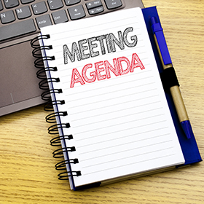
Meeting Agenda
September 21, ,2023
CALL TO ORDER
PLEDGE OF ALLEGIANCE
ROLL CALL
PREVIOUS MEETING MINUTES
TREASURER REPORT/BILLS PAYABLE
SECRETARY REPORT
CORRESPONDENCE
PUBLIC COMMMENT
PROFESSIONAL REPORTS-POLICE, FIRE,SOLICITOR,ZONING,ENGINEER,TAX COLLECTOR,MAYOR
COMMITTEE REPORTS-SAFETY,PLANNING,FINANCE,SHADE TREE,REC,MS4,DPW
MELLOW COURT FOLLOW UP
NORLACK AGREEMENT
POLICE PENSION PLAN RESOLUTION
RUSHBROOK CREEK LSA STATEWIDE APPLICATION RESOLUTION
RUSHBROOK CREEK LSA MONROE APPLICATION RESOLUTION
DPW TRUCK LSA APPLICATION RESOLUTION
EXECUTIVE SESSION FOR PERSONNEL ISSUES
NEW BUSINESS

Slide 3
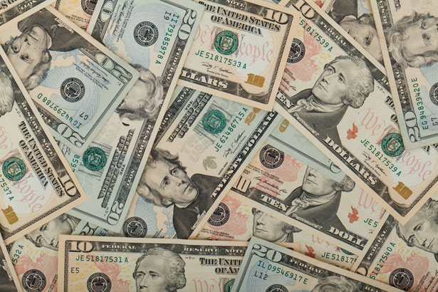
Treasurer’s report
9/21/2023
ASSETS
Checking/Savings
American Rescue Plan Fund 135,727.05 Capital Reserve - DPW 729.47
Capital Reserve - Police 5,324.82
Crime Watch Fund 222.69
General Fund - Community 115,749.07 General Fund - FNB 6,656.08
Holiday Lights Fund 1,459.09

Slide 4
Treasurer’s report
Investment - General Fund 1,045.58
Investment - Liquid Fuels 23,021.58
Investment - Paving Fund 1,056.46
Investment - Recycling 115.49
Investment - Refuse 164.66
Liquid Fuels - FNB 40,932.71
Petty Cash 223.00
Recreations Fund 27,816.25
Recycling - Community 3,163.93
Refuse Checking - FNB 162,997.06
Total Checking/Savings 526,404.99

Slide 5
Treasurer’s report
200000 · Accounts Payable 10,314.47
Long Term Debt 160,529.30

Slide 6


